Slide 1
Graduate placement opportunities within the AAI section, ISIS Facility
Anders Markvardsen
Online
16th Oct 2020
AAI = Analysis, Analytics and Infrastructure

Slide 2
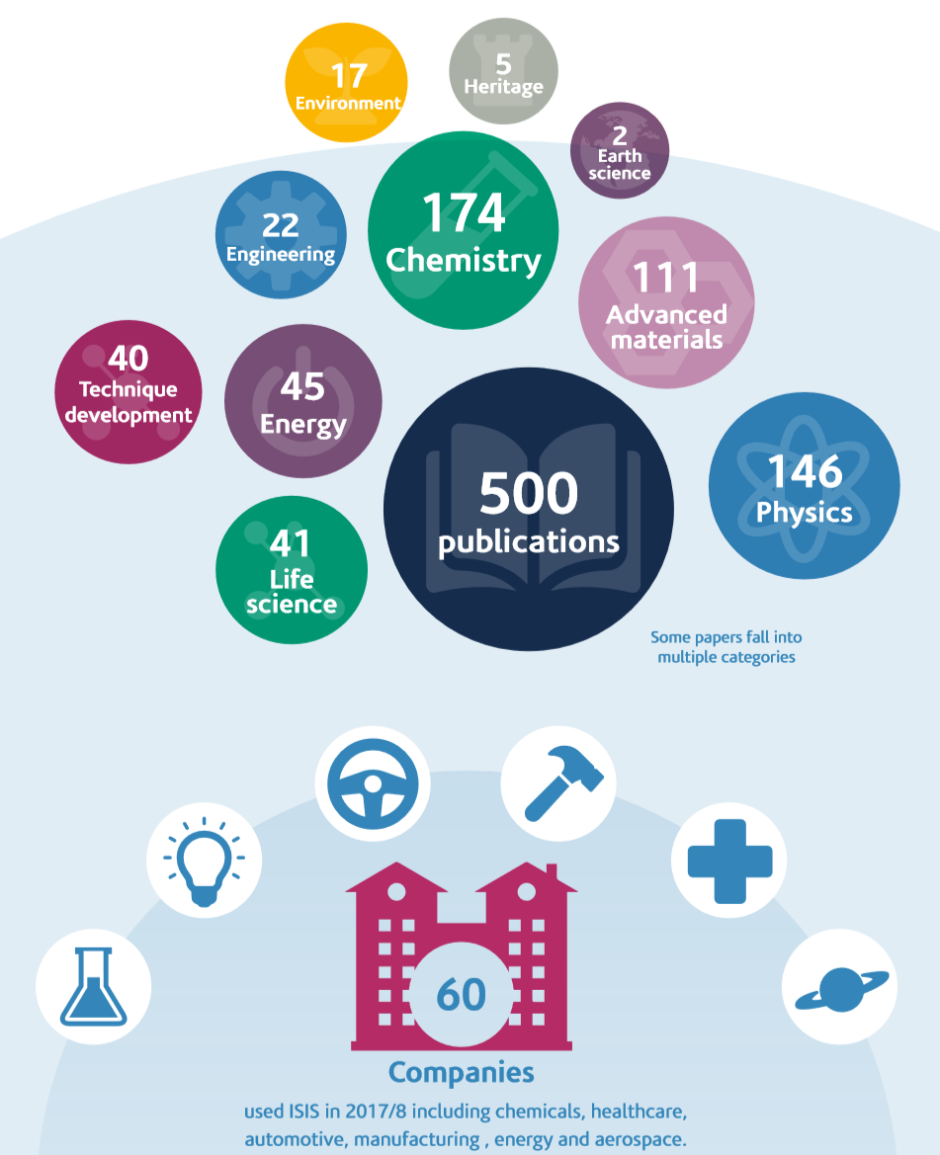
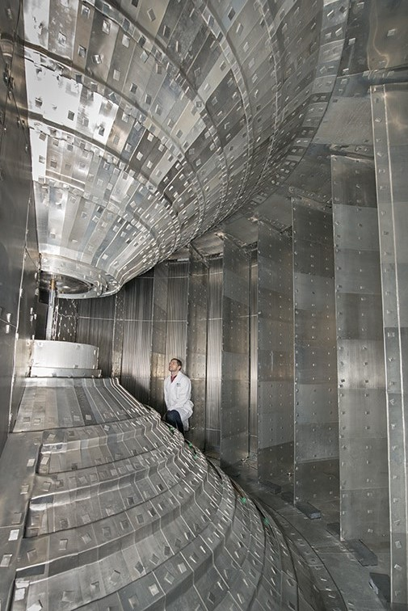
https://www.isis.stfc.ac.uk/Pages/Let.aspx https://www.isis.stfc.ac.uk/Pages/ISIS_Annual_review_2018.pdf

Slide 3
AAI section
https://stfc365.sharepoint.com/sites/AnalysisAnalyticsandInfrastructuresection
Experiment Control
Data Acquisition
Data
Reduction
Data
Analysis
Data Infrastructure
Data Analytics

Slide 4
Analysis
Contribute to:
MDMC (Molecular Dynamics Monte Carlo)
FitBenchmarking
https://stfc365.sharepoint.com/sites/AnalysisAnalyticsandInfrastructuresection/SitePages/Analysis.aspx

Slide 5
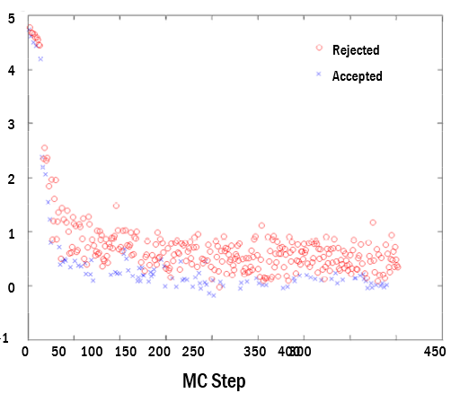
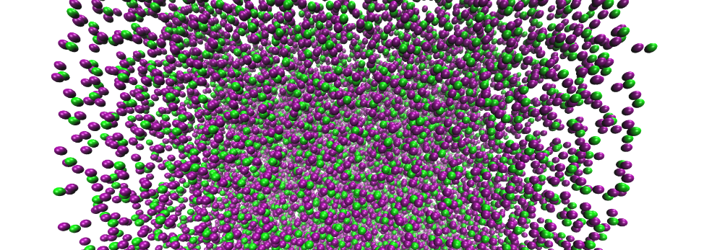



Analysis - MDMC
Molecular Dynamics Monte Carlo
Molecular Dynamics
MDMC
package
Monte Carlo
www.mdmcproject.org

Slide 6
Analysis - MDMC
Skills: Science-ish (material simulations), Soft. Eng.-ish (python, containers and HPC)
Opportunities:
Starting from Jan:
Project to interface with machine-learnt inter-atomic potentials library
Containerisation Singularity / Docker and deployment options
Other customised opportunities could be considered
Starting April:
project with SCD Computational Chemistry group to interface with DL_Poly (MD engine)

Slide 7
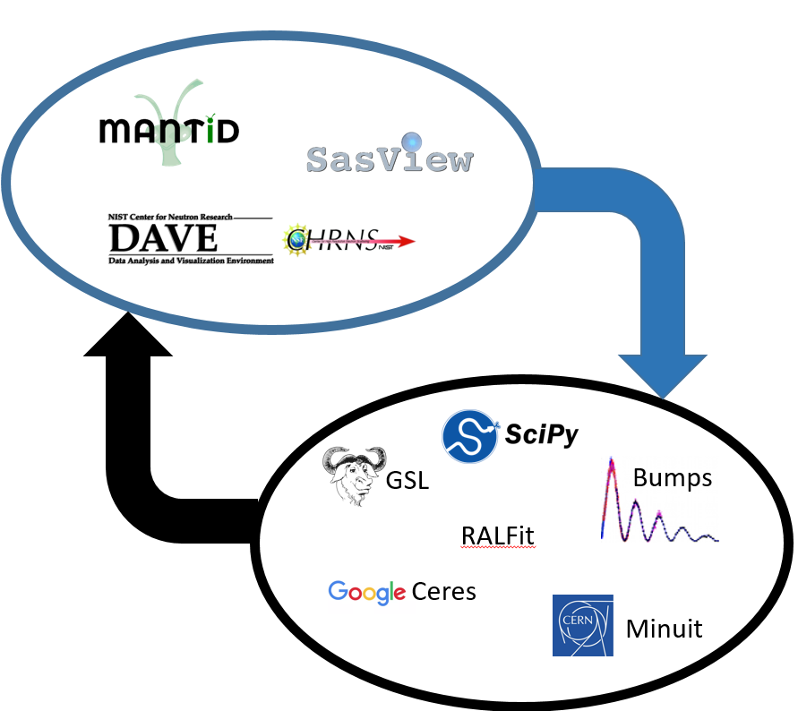
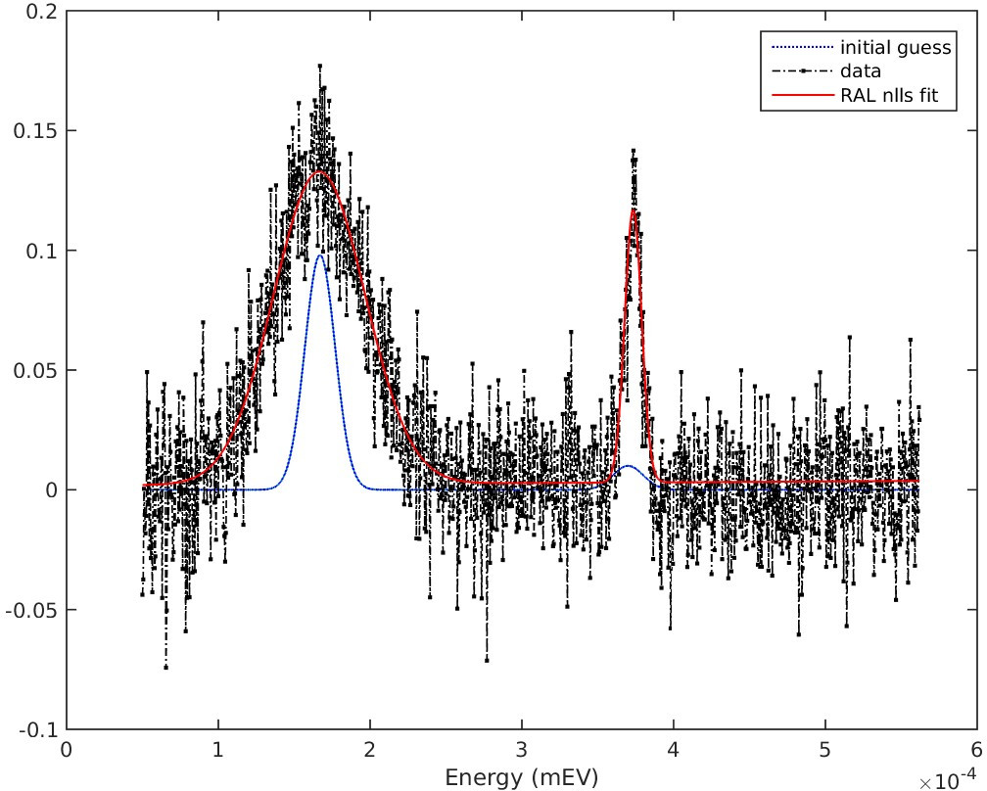

Analysis - FitBenchmarking
http://www.fitbenchmarking.com/
SCD Computational Mathematics group

Slide 8
Analysis - FitBenchmarking
Skills: Science-ish (math/facility data), Soft. Eng.-ish (python, usability, optimisation)
Opportunities from Jan:
Applying FitBenchmarking to new classes of facility software
Extend the framework itself usability or new functionality (global minimizers)
Commercialisation project
And again customisation possible
SCD Computational Mathematics group

Slide 9
Analytics
First ISIS-ML (ML=Machine Learning) proposal call ending 27th Sep 2020, and kick-off of the approved proposals 14th Oct 2020!
Opportunity from Jan: Help with making this new process programme a success
Skills: planning tools, exploring software-ML needs for a research facility
SCD SciML group

Slide 10
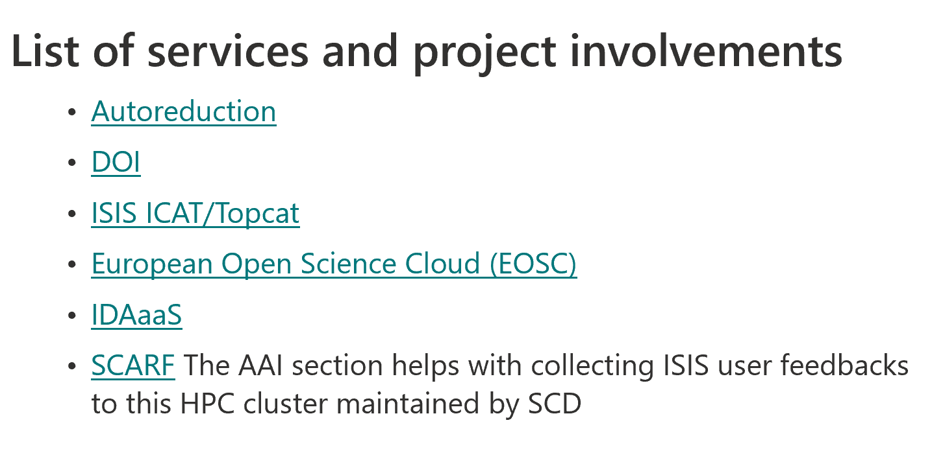
Infrastructure
https://stfc365.sharepoint.com/sites/AnalysisAnalyticsandInfrastructuresection/SitePages/Infrast.aspx

Slide 11
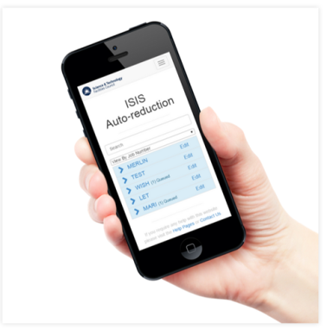


Infrastructure - Autoreduction
Automated reduction (processing) of ISIS raw data
24 hour service
ISIS Data Cache Monitor
messages
messages
messages
Web interface
Compute
resources
Messaging Server
https://github.com/ISISScientificComputing/autoreduce

Slide 12
Infrastructure - Autoreduction
Skills: Soft. Eng.-ish (python, Django, system deployment, etc..)
Opportunities from March:
On-boarding new instruments
Cloud compatible
Dynamical plotting
“A holy grail” – reproducibility!
https://github.com/ISISScientificComputing/autoreduce-documents/blob/master/projects/sub-projects.md

Slide 13
Thank you for listening

